Slide 1
Quality Circle Forum of India
presents
Problem Solving Techniques
- a simplified revised practical guide

Slide 2
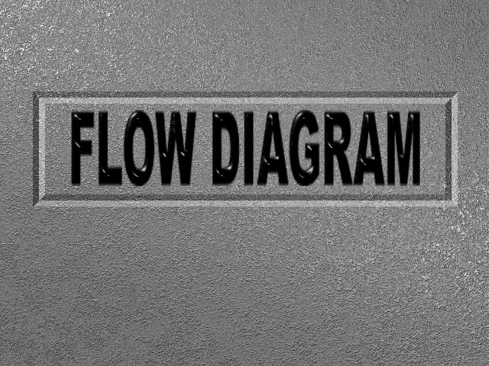

Slide 3
What is Flow Diagram?
Flow Diagram is graphical or pictorial way to depict a process. With the help of a flow diagram we can show process sequence. It can be used to dissect a process for better understanding and analysing. It can also be used for re-planning or making a change.
The process may be a manufacturing process of a product (entire or segment), a service provided, to convey some information or a combination of any of them.

Slide 4
Start
A flow chart for a program to print Natural numbers from 1 to 10.
N=0
Stop
N=N+1
Yes
Is N=10
Print N
No
Flow diagram is a graphical or a pictorial way to depict a process.

Slide 5
LET US LOOK AT THE PROCESS OF MAKING COFFEE
START
Remove the decoction after it percolates
Add milk and sugar to it and your coffee is ready
Roast coffee seeds till they are dark brown and start cracking
Let the decoction percolate
STOP
Are the
seeds brown & has the cracking ceased
NO
Add boiling water on top of the coffee powder
YES
Fill half of the percolater with coffee powder and level properly
Grind the seeds coarsely
With the help of a flow diagram we can show process sequence.

Slide 6

Often it is called an ‘armchair journey’ into a process as it helps to have a clarity of the process without visiting the actual spot.

Slide 7
It can also be used to dissect a process for better understanding and analysis

Slide 8

SIR, BEFORE THAT I THINK WE SHOULD MAKE A FLOW DIAGRAM OF THE EXISTING PROCESS. IT SHOULD HELP US TO REPLAN MORE MEANINGFULLY
I THINK WE WILL HAVE TO REPLAN THE WHOLE PROCESS
It can also be used for re-planning or making a change.

Slide 9
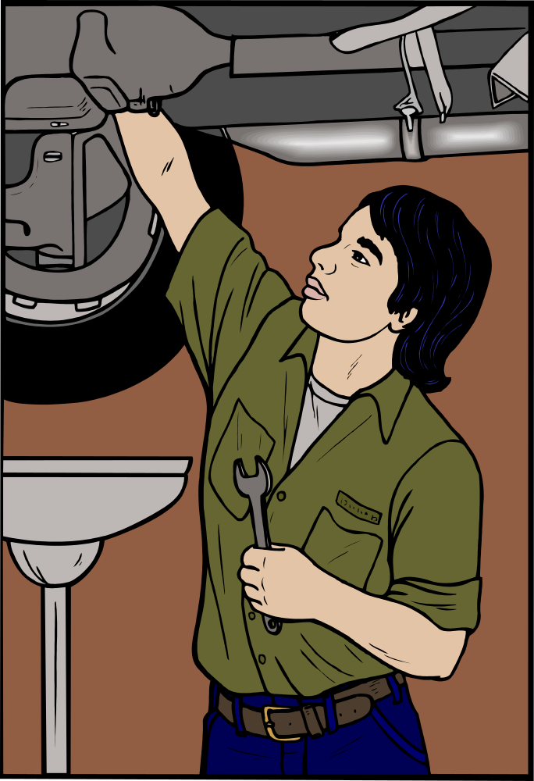
The process may be a manufacturing process of a product (entire or segment)

Slide 10

A service provided

Slide 11

To convey some information

Slide 12
Or a combination of any of them

Slide 13

AH !!! NOW I KNOW WHAT THE PROBLEM IS !!
Study of a process with the help of a Flow diagram helps the team to have an insight into the potential problems

Slide 14

Bottlenecks

Slide 15

Sir, if you notice this part of the process is totally unnecessary
Redundant steps and

Slide 16
Sir, just have a look at this flow diagram. I think we are repeating this part of the process twice.
Rework loops

Slide 17

With the help of a Flow diagram the team will have a common and precise knowledge of the process

Slide 18

Flow Diagrams in Problem Solving
Indeed, it is computer programmers who have made Flow diagram a popular process for computer usage.

Slide 19

Flow Diagrams in Problem Solving
Start
N=0
Stop
N=N+1
Yes
Is N=10
Print N
No
Since computers can function only in the way it is programmed, system analysts use Flow Diagram to ensure that all aspects involved in the process are covered while programming.

Slide 20

Flow Diagrams in Problem Solving
Any step overlooked may otherwise affect its function
and the efficiency.

Slide 21
Flow Diagrams in Problem Solving
Flow diagram is a powerful tool which helps to do a thorough analysis

Slide 22
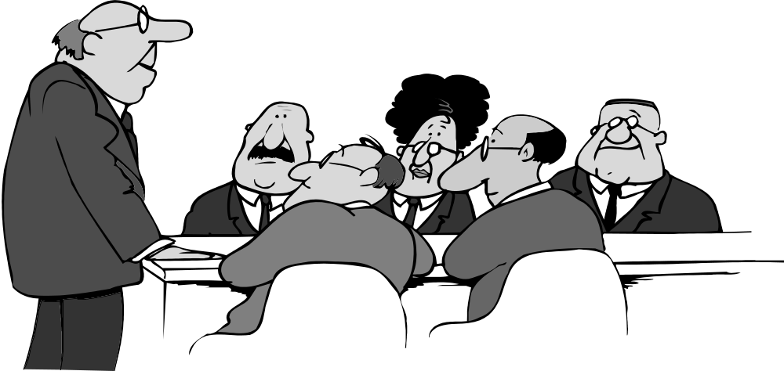
Obviously for problem solving, Quality Circles, Task Forces, Quality Improvement Teams etc., should make use of it.

Slide 23
There are three type of Flow Diagrams viz.
1. High level Flow diagram
2. Matrix Flow diagram
3. Detailed Flow diagram

Slide 24
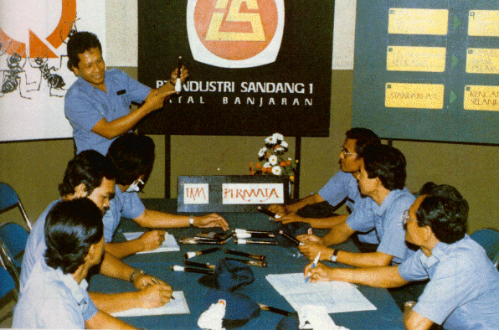
Quality Circle members should have the knowledge of all the three types of Flow diagrams. They all have a distinct purpose and usefulness in problem solving activities.

Slide 25
High level Flow diagram

Slide 26
This is making the diagram of the total process in a broad way. Here details are avoided.
Let us take one example for explaining all the three types of Flow Diagram.

Slide 27

High level Flow diagrams
Mr. A is working in a company.
He needs some materials for his work.

Slide 28

They have a computerised system for stock record, and he checks the computer for the materials’ availability.

Slide 29
When he finds it inadequate or nil, he immediately
places an indent.
INDENT

Slide 30

Based on the indent, order is raised and material is procured and he receives the materials.

Slide 31
USER SENDS INDENT
INSPECTED
USER OBTAINS
QUOTATION OBTAINED
MATERIAL RECEIVED
MATERIAL ORDERED
MATERIAL MADE
This is shown in a High Level Flow diagram drawn here.

Slide 32
Matrix Flow diagram

Slide 33
Actual procedure of material procurement is not as simple as that.

Slide 34

There are various departments and agencies involved in the process. Organisations have departmental entities.

Slide 35
USER PURCHASE MANUFAC STORES INSPEC -TURER -TION
USER SENDS INDENT
QUOTATION OBTAINED
MATERIAL ORDERED
MATERIAL
MADE
MATERIAL RECEIVED
INSPECTED
USER
OBTAINS
Hence the same Flow diagram can be drawn
in a Matrix format as shown here

Slide 36
Now let us see a
Detailed Flow Diagram.

Slide 37
Detailed Flow Diagram uses certain symbols.

Slide 38
What are the Symbols ?

Slide 39
Activity Symbol
It is a rectangle in which brief description of an activity involved at that step is mentioned

Slide 40
Decision Symbol
It is a diamond used to depict a decision point from which a process branches into two or more paths.

Slide 41
Decision Symbol
NO
YES
The path one takes depend upon the answer to the question mentioned in that symbol, naturally there will be more than one path, and each path is labelled according to the answer.

Slide 42
Terminal Symbol
It is a rounded rectangle indicating the beginning and end of a process or Flow diagram. The words used in the terminal symbol at the beginning is “start” and at the end of the process the word is “end”. (Maybe some other appropriate word could also be used).

Slide 43
Document Symbol
It is used to depict a document pertaining to the process

Slide 44
Data Base Symbol
This indicates electronically stored information which pertain to the process.

Slide 45
FLOW LINES
They are basically arrow head used to indicate the direction of the process flow, from a decision symbol to two or more different paths. Flow lines help you to find out the continuity not only for the entire process flow but also the path of each rework loop.

Slide 46
Connector
Sometimes it may not be possible that the entire process has a Flow diagram in a single sheet.

Slide 47
Connector
Some areas may have to be drawn in a separate sheet

Slide 48
Connector
Connector symbol which is a small circle helps to show continuity of the process. A letter or a number can be written in that for finding out the continuity.

Slide 49
People draw Flow diagrams in different ways.

Slide 50
But once someone is familiar with the system of making Flow diagram, it is advisable and desirable to use standard symbols.

Slide 51
Quality Circle members may use only rectangles. But once they become familiar in constructing flow diagrams, use of symbols is a must as it shows the situation correctly.

Slide 52
Symbol can help us to concentrate upon a particulars aspect e.g.: we want to study the activities. Look into activity symbol.

Slide 53
If we are interested in decision making aspect look only at diamond symbol.

Slide 54
Why should we make a
Detailed Flow Diagram ?

Slide 55
Even the process of procuring material is not as simple as it is depicted in the Matrix Flow diagram. There are many possible problems, bottlenecks, etc. in a process.

Slide 56

Unless and until we thoroughly plan for all eventualities the job may not get completed and it may get stuck up at any place during the process.

Slide 57

To overcome this we draw a Detailed Flow diagram looking into all possible obstacles.

Slide 58
NOW LET US GO BACK TO THE ORIGINAL EXAMPLE WHICH WAS SHOWN IN HIGH LEVEL FLOW DIAGRAM AS WELL AS IN MATRIX FLOW DIAGRAM.
LET US NOW MAKE A DETAILED FLOW DIAGRAM FOR THAT.

Slide 59
Detailed Flow Diagram
START
Mtrl. needed
Mtrl. database
Material needed. Checked up the availability in database.

Slide 60
Detailed Flow Diagram
START
Mtrl. needed
Mtrl. database
Is
it
There
Yes
Yes, material is available.

Slide 61
Detailed Flow Diagram
START
Mtrl. needed
Mtrl. database
Is
it
There
Yes
Send Reqsn.
Mtrl. Obtained
Send requisition, material received and process is over.
STOP

Slide 62
Detailed Flow Diagram
START
Raise Indent
Mtrl. needed
Indent Recd.
Mtrl. database
Is
it
There
No
Yes
Send Reqsn.
Mtrl. Obtained
No, send the purchase indent.
STOP

Slide 63
Detailed Flow Diagram
START
Raise Indent
Mtrl. needed
Indent Recd.
Mtrl. database
Is it OK
Is
it
There
No
Yes
Send Reqsn.
Mtrl. Obtained
Is the indent in order ?
STOP

Slide 64
Detailed Flow Diagram
START
Raise Indent
Mtrl. needed
Indent Recd.
Mtrl. database
No
Return for correction
Is it OK
Is
it
There
No
Yes
Send Reqsn.
Mtrl. Obtained
No, send it back for amendment.
STOP

Slide 65
Detailed Flow Diagram
START
Raise Indent
Mtrl. needed
Indent Recd.
Mtrl. database
No
Return for correction
Is it OK
Yes
Is
it
There
No
Send Enqrs.
Yes
Send Reqsn.
Qtn. OK
Yes, in order. Ask for Quotation.
Is it in order ?
Mtrl. Obtained
STOP

Slide 66
Detailed Flow Diagram
START
Raise Indent
Mtrl. needed
Indent Recd.
Mtrl. database
No
Return for correction
Is it OK
Yes
Is
it
There
No
Send Enqrs.
Yes
Send Reqsn.
Qtn. OK
No
Mtrl. Obtained
No, ask for fresh quotation.
STOP

Slide 67
Detailed Flow Diagram
Raise Indent
Place order
START
Mtrl. needed
Indent Recd.
Mtrl. made
Mtrl. database
No
Return for correction
Mtrl. recd.
Is it OK
Yes
Inspection
Is
it
There
No
Send Enqrs.
Yes
Send Reqsn.
Qtn. OK
No
Mtrl. Obtained
Yes
OK, then place order. Material made, inspected for conformity.
STOP

Slide 68
Detailed Flow Diagram
Raise Indent
Place order
START
Mtrl. needed
Indent Recd.
Mtrl. made
Mtrl. database
No
Return for correction
Mtrl. recd.
Is it OK
Yes
Inspection
Is
it
There
No
Send Enqrs.
Yes
Is it OK
Send Reqsn.
Qtn. OK
No
Mtrl. Obtained
Yes
Is it OK ?
STOP

Slide 69
Detailed Flow Diagram
Raise Indent
Place order
START
Mtrl. needed
Indent Recd.
Mtrl. made
Mtrl. database
No
Return for correction
Mtrl. recd.
Is it OK
Yes
Inspection
Is
it
There
No
Send Enqrs.
Yes
Is it OK
No
Return to supplier
Send Reqsn.
Qtn. OK
No
Mtrl. Obtained
Yes
No, reject or send it for repair.
STOP

Slide 70
Detailed Flow Diagram
START
Raise Indent
Place order
Mtrl. needed
Indent Recd.
Mtrl. made
Mtrl. database
No
Return for correction
Mtrl. recd.
Is it OK
Yes
Inspection
Is
it
There
No
Send Enqrs.
Yes
Is it OK
No
Return to supplier
Send Reqsn.
Qtn. OK
No
Yes
OK, take it in stock. Material collected & Process is over.
Mtrl. Obtained
Take ass tock
Yes
STOP
Put in database

Slide 71
In the detailed Flow diagram shown here, there are still more steps that can be thought of.
For example, examining whether the material is really needed, who is ordering, is he authorised, is there a budgetary control,
is it within that limit etc.

Slide 72

Clarify or better understanding of the process
Sir, I do not understand that.
Let us draw a flow diagram, then you will understand.
Quality circle as a team is trying to solve problems. Hence it is necessary that all the members should have a clear knowledge or understanding about the problem.

Slide 73
Ah!! Now I understand.
This understanding can be brought to the team with the help of a Flow diagram.

Slide 74
Mr. Dass will make the flow diagram. He understands the entire process thoroughly. He will also take the help of other members who have knowledge about some part of the process.
Suggested method for making a flow diagram.

Slide 75
Collectively the Flow diagram can be made, so that everyone in the group can go through it step by step for better understanding.

Slide 76
Such an understanding will help to carry out the tasks such as:
Working out a strategy for the required data

Slide 77

To estimate the cost involved

Slide 78

To find out the individual's view or opinion about the problem.

Slide 79
?
Reason for taking up the task

Slide 80
PRESENT PROCESS
PROPOSED CHANGES
To explain the present process and the proposed changes.

Slide 81

To work out a plan for implementing the solution.

Slide 82

To provide the required training for carrying out the process.

Slide 83
PREPLAN OR CHANGE OF PROCESS

Slide 84

Before carrying out a change we should carefully study the proposal.

Slide 85
PRESENT PROCESS
PROPOSED CHANGES
A Flow diagram prepared depicting the change will help us greatly.

Slide 86

This way we will have a clear idea before the implementation about the proposed changes.

Slide 87

SHUT UP !!! I AM NOT GOING TO LISTEN TO A WORD YOU SAY.
Besides the clarity about the proposed change, it will also help to find out the possible resistance

Slide 88
How to make use of a Flow diagram

Slide 89
START
Remove the decoction after it percolates
Add milk and sugar to it and your coffee is ready
Roast coffee seeds till they are dark brown and start cracking
Let the decoction percolate
STOP
Are the
seeds brown & has the cracking ceased
NO
Add boiling water on top of the coffee powder
YES
Fill half of the percolater with coffee powder and level properly
Grind the seeds coarsely
As mentioned earlier flow diagrams are the best way to depict a process. It can be used for different purposes in problem solving.

Slide 90

AH !!! NOW I UNDERSTAND
It can be used for better understanding of the process. This can be used in case of a change or for introducing a new process.

Slide 91
Gentlemen, If you notice the second decision symbol can be totally eliminated if --------------------------------
If any process is not working properly we always like to amend or alter or replace that. A flow diagram drawn at this stage will help us to improve the efficiency or to make a significant breakthrough.

Slide 92
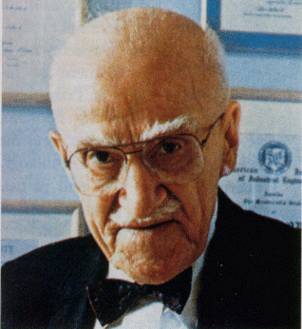
Dr. J.M. Juran suggests a four step approach for such an analysis

Slide 93

Step 1:
DECISION SYMBOL
Examine each decision making symbol. This symbol has got the shape of a diamond.

Slide 94
Process Flow may branch out into two or three points depending upon the decision.

Slide 95

This Decision symbol is incomplete
Look here for redundant, unnecessary or incomplete activity.

Slide 96

Change or elimination of any of them may help in reducing the cost or waste. It may also lead to increase in productivity.

Slide 97
Step 2:
ACTIVITY SYMBOL
Examining each activity symbol

Slide 98
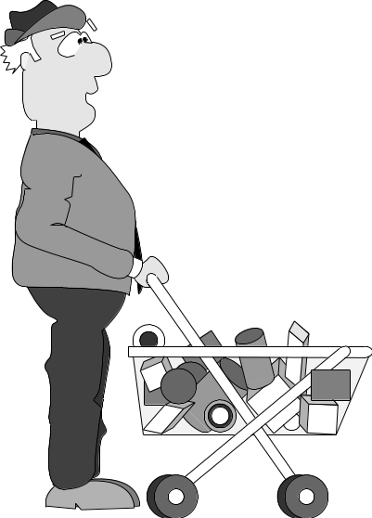
Here we examine the value of each activity related to its cost and needs of the customer.

Slide 99
They should discuss prevention of errors by improving design of activity.

Slide 100
Step 3:
Examining each rework loop

Slide 101

A team should examine the activities in the rework loop and identify those which could be eliminated.

Slide 102
It should use the existing information in the current rework loop to prevent errors from recurring

Slide 103
LONG REWORK LOOP
SHORTENED REWORK LOOP
Quality Circle members should check for different ways to shorten the rework loop by streamlining the process of correction when an error occurs.

Slide 104
Step 4:
DATABASE SYMBOL
DOCUMENT SYMBOL
Examining Each Document or Data Base Symbol

Slide 105

Documents and data bases are important sources of information.

Slide 106

The Circle should examine the mechanisms for keeping the information up to date. Out of date information can generate errors.

Slide 107
PITFALLS

Slide 108

I AM THE BOSS OVER HERE. I WILL PREPARE THE PROCEDURE.
In most of the organisations procedure for a process area is prepared by those who are not involved in actual implementation or practice.

Slide 109

THIS DOES NOT MAKE ANY SENSE!!
With the result the implementers as and when they face a practical difficulty make a change, add or overlook certain steps.

Slide 110

This may become a regular working practice. But when a Flow diagram is asked to be drawn this shortcut process may not be mentioned out of fear.
BOSS WILL FIRE ME IF COMES TO KNOW I AM USING SHORTCUTS !!?

Slide 111

Obviously such diagrams which do not reflect the real situation is useless.

Slide 112

Mr. Gharbanda, the information in the dispatch letter is inadequate. I am sending it back to you for correction.
Despatch section received a letter with inadequate information. It is sent back for correction.

Slide 113
REWORK LOOP
Similarly in a process, some defects are noticed and they get rectified. Such activities are normally to be shown under rework loop.

Slide 114
VERY IMPORTANT
While making a Flow diagram we may overlook such rework loop taking them as inevitable or as minor. This is also not correct. While making a Flow diagram we should not forget to show rework loops.

Slide 115

What if I do not know about the process? You can tell me about it. I will not let any one else draw the FLOW DIAGRAM.
Sometimes Flow diagrams are made by people who are not well versed with the process.

Slide 116

What did I MISS!!!
They may overlook certain important points due to lack of knowledge. Even the two problems mentioned earlier can be caused by such people.

Slide 117
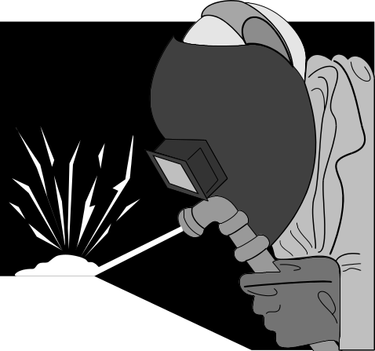


Hence Flow diagrams have to be made by those who are actually involved and have the knowledge of the process.

Slide 118
When to draw Flow diagrams ?

Slide 119
Process of selling material ( QC booklets & A-V Tools ) by QCFI
START
Despatch Material
STOP
Receiving Enquiry for material
Receive Check/DD
Filing the Enquiry
Send price list to buyer
YES
NO
Check database for Avail.
Is stock available?
Order Material
For defining the process flow

Slide 120

The whole process of ordering material takes me FIVE weeks
For defining the problem

Slide 121

The problem is that the whole process of enquiring, sending price list and payment for material is done through post. All this takes a very long time.
For identifying the root causes

Slide 122

If we use E-mail facility for enquiring and for sending Price list we can save some time. If we accept credit cards and if the money transaction is done through wire we can cut down the process time to a week.
For devising the solution

Slide 123
START
Confirm with bank if money is deposited
Despatch Material
Receiving enquiry for material through E- mail. (Filing is done Automatically
Send price list to buyer using E-mail.
STOP
YES
Is stock available?
NO
Check database for Avail.
Order Material
For implementing the solution

Slide 124

START
Confirm with bank if money is deposited
Despatch Material
Receiving enquiry for material through E- mail. (Filing is done Automatically
Send price list to buyer using E-mail.
STOP
YES
Check database for Avail.
Is stock available?
NO
Order Material
At the time of review / follow up

Slide 125
How to draw
a
Flow diagram ?

Slide 126

Discuss the purpose of it

Slide 127

Decide on your expectation

Slide 128

Decide the boundaries

Slide 129

Put each process in writing from the beginning

Slide 130
When you come to a decision area follow one till you complete

Slide 131
For unknown areas check up later on and complete.

Slide 132
Ensure every branch is completed

Slide 133

Review it and ask other members also to review

Slide 134
How to ensure accuracy ?

Slide 135

Ensure that it is about actual process and not what is intended.

Slide 136
Ensure rework loops are not omitted.

Slide 137
Be honest about what you do

Slide 138

Observe process before drawing Flow diagram

Slide 139
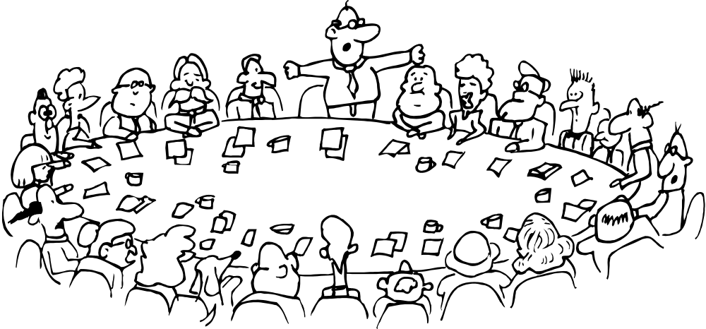
Elicit support of other members for accuracy and completeness and allow them to review it

Slide 140
SUMMARY
Flow diagram is a graphical or pictorial depiction of a process.
It can be effectively made use of by Quality Circle to understand a process as well as to make necessary changes.
To be useful, a Flow diagram should be accurate.
There are three types of Flow diagrams.
Certain symbols are used for making these Flow diagrams.
Flow diagrams have many effective uses.

Slide 141

Prepared by
G. Vijaykumar

Slide 142


